Slide 1

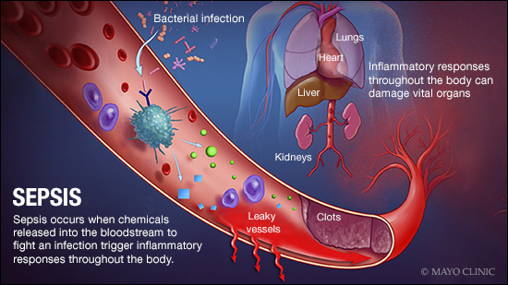



Early Detection of Sepsis In ICU Patients
Jan Michael Austria
Notes:
Slide 1
Hi everyone I’m Mike . Today I’ll be talking about work I’ve done for creating an algorithm to detect Sepsis in ICU Patients.

Slide 2
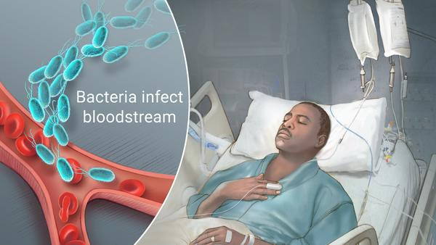
Sepsis can be dangerous!
Life threatening condition caused by body’s response to infection.
The body naturally release chemicals to fight off infection
Chemical imbalance can result in multiple organ failure.
Shortness of Breath
High heart Rate
Fever
Notes:
Script
Sepsis is a potentially life-threatening condition caused by the body's response to an infection. The body normally releases chemicals into the bloodstream to fight an infection. However, when the body's response to these chemicals are out of balance, multiple organ failure can occur. Symptoms include Shortness of Breath, High heart rate, and fever and death in some cases.

Slide 3
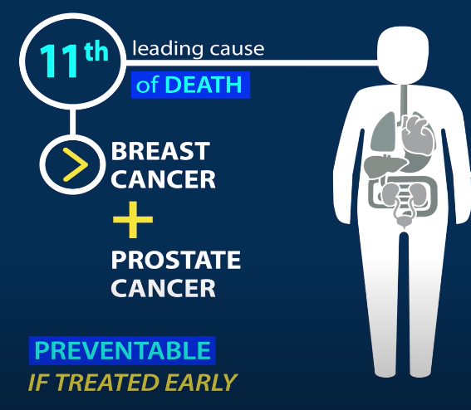
Sepsis is Preventable if diagnosed early
1.7 million people developed sepsis in 2018
270,000 people died from sepsis in the same year
Can we identify when a patient will start experiencing sepsis symptoms early enough?
Notes:
Script
The problem is that sepsis is the 11th leading cause of death for patients in the ICU. About 1.7 million people develop Sepsis and of those 270,000 die. On average, however, a third of these deaths could have been prevented if diagnosed earlier. My Idea is to use to deep learning techniques to help medical professionals, identify when sepsis will occur as early as possible. But how would this work in practice? Let me show you how this would work. (Open Demo)
Demo Script
I created a tool that allows medical professionals to predict when a patient will go into septic. You provide the algorithm with 36 hours of patient observation data. The algorithm will provide the probability that a patient will go into sepsis in the next 12 hours. Here are the column indicator labels. Below is a data visualizer for medical professionals to track when the patient goes into sepsis, as well as any one of the 33 covariates. Finally, the probability trajectory at each hour for this patient is returned. For this example, the patient went into sepsis after 254 hours in the ICU, but a warning for sepsis could have been thrown after the patients' 243 hour. So how did I arrive here?

Slide 4
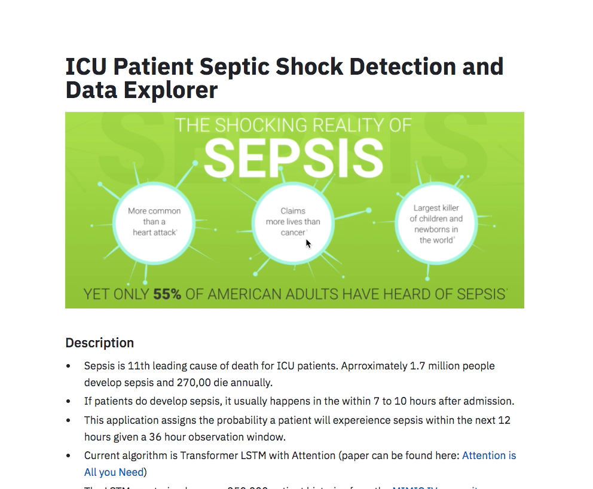
Notes:
Demo Script
I created a tool that allows medical professionals to predict when a patient will go into sepsis. You provide the algorithm with 36 hours of patient observation data. And the algorithm will provide the probability that a patient will go into sepsis in the next 12 hours. Here are the column indicator labels. Below is a data visualizer for medical professionals to track when the patient does go into sepsis, as well as any one of the 33 covariates. Finally, the probability trajectory at each hour for this patient is returned. For this example, the patient went into sepsis after 254 hours in the ICU, but a warning for sepsis could have been thrown a few hours earlier. So how did I arrive here?

Slide 5

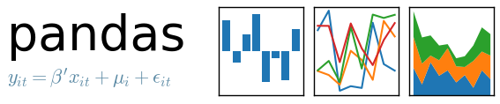
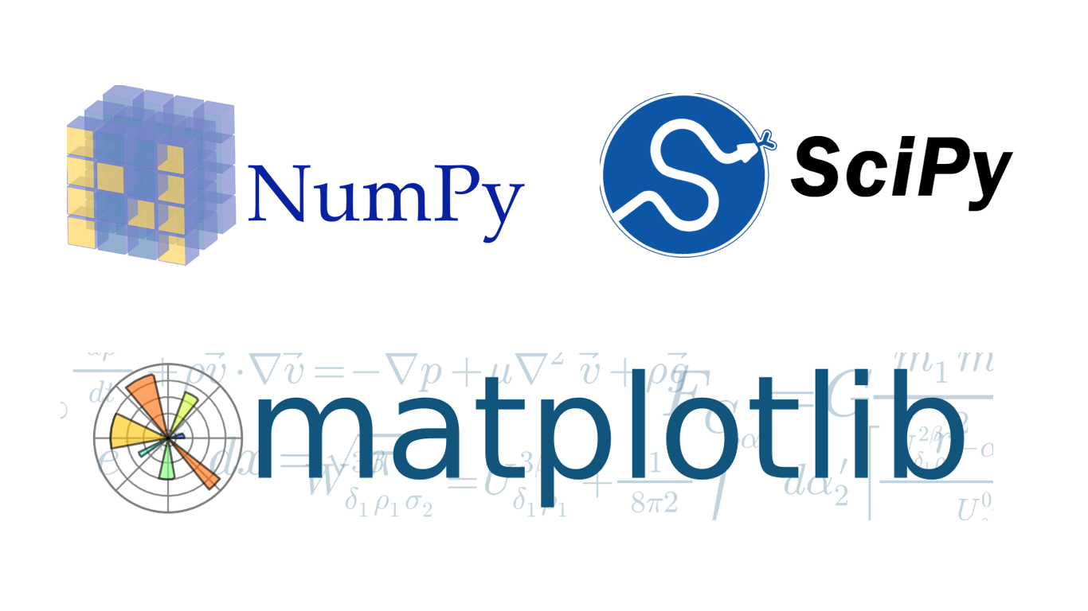





Pipeline: Data Acquisition and Cleaning
Data Retrieval and Ingestion
Aggregation
Time Series Classification
Final Deployment
Sepsis Label Offsets and Interpolation
30 millions records from 5 hospitals
10 different tables (pathology labs, multiple indicators)
Isolate ICU patients, sepsis and no sepsis
Combined with labs sensor data
Adjust to 36 hours
Offset Sepsis onset labels back 12 hours
Interpolate linearly
XGBoost
LSTM with Attention
Binary Cross Entropy
Streamlit and deployed via Heroku
C++ app - faster implementation
Notes:
Script
I started with the MICIV IV repository which contains 30 million patient records for some select hospitals in Boston. I extracted all records of ICU patients with labels of whether or not they went into sepsis and merged these patient profiles with sensor and lab data. I aggregated to 36 hours and then linearly interpolated. I then trained an LSTM to get continuous predictions at each hour and XGBoost to obtain what features are most important I finally deployed a streamlit app on Heroku, and created C++ app for faster implementation use in hospitals.

Slide 6
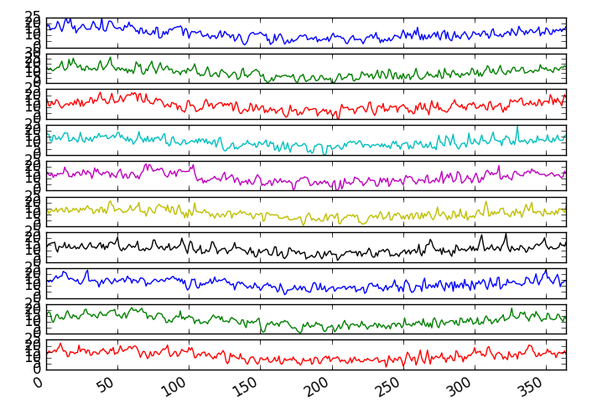
Multivariate Time Series: Too Many!
33 time series indicators
Indicator | Description
HR | Heart Rate (beats per minute)
O2Sat | Pulse Oximetry (%)
Temp | Body temperature (deg C)
SBP | Systolic BP (mm Hg)
DBP | Diastolic BP (mm HG)
Resp | Respiration rate (breaths per minute)
Age | Years
Gender | M/F
ICULOS | Time patient has been in ICU (Hours
Notes:
Slide 4
Because there are so many features available for each patient and generating all possible feature permutations for feature engineering would take an O(n!) amount of time, I decided to use an LSTM with attention model. The model allows for continuous predictions at each time point and considers the temporal evolution of the features. The attention part of the network allows the model to infer what are the most important indicators for identifying sepsis.

Slide 7
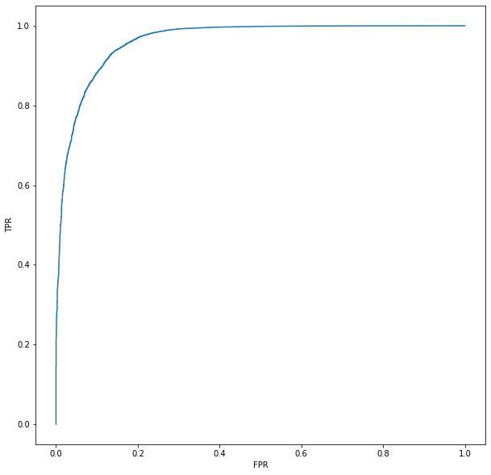


Predictive Model: LSTM with Attention
ROC Curve
Highly Imbalanced Data
Test Results (For All Times)
True Positive Rate
Metric | Score
Recall | .91
AUC | .92
False Positive Rate
Notes:
Script
Because of the imbalance in the dataset, training the model was difficult. Prevalence of sepsis is less than 2%. To adjust for this, I used a weighted loss function to penalize the estimator more when it incorrectly predicted a person was going into sepsis. The most important metric to optimize in a hospital setting is recall, which was 91%. I can say of the patients that actually developed sepsis, the model predicted 91% of them within 12 hours. The AUC score, is also very high for this model, around .92. Keeping in mind that a perfect estimator hugs the top left corner, and an estimator doing no better than random guessing is closer to the red line.
Slide 7
1.4 % sepsis events
11.5 million non sepsis labels to 158k labels
Pros
True time series prediction, not memoryless
Considers changes in sensor data
Very predictive
Cons
Not as explainable
More difficult to define a valuation metric
For my alogithm, I used an LSTM with attention model. The model treats the data as a true time series, but is less explainable. The reporting metrics look great with recall being around 96%. The left plot shows the trajectory of patient developing sepsis after being in the ICU for 256 hours in blue.. The red line shows the LSTM’s probability of sepsis at every time point. At around the 246th hour mark, the LSTM is predicting more than 50% chance of sepsis at this hour, and even more 1 hour before the patient goes into sepsis. That’s pretty good! The right plot shows a patient not developing sepsis with low probabilities returned by the estimator throughout the observation window. Overall, this is pretty good!
Disitinquish them better, positive patient and negative patient

Slide 8
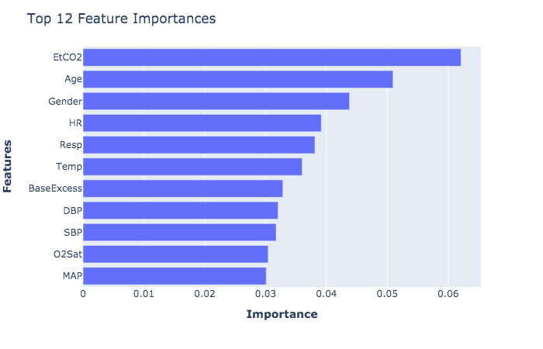
Carbon Dioxide Levels, Age, Gender, and Heart rate Matter
Notes:
Slide 6
To unlock some of the innerworkings of the LSTM model and to make the model more interpretable, I used XGBoost’s Feature Importance option to identify which indicators are most important. Carbon Dioxide Levels, Age, Gender, and Heart Rate Matter the most, while features like mean artery pressure, saturated oxygen, and systolic blood pressure do no matter at much. Intuitively, older patients would be more at risk than younger patients if onset of sepsis were to occur.
FIx Delta t
XGBoost
Used widely in the medical field to predict patient outcomes
Interpretable
Feature Importance
Good preliminary results without any hyperparameter tuning
Cons
Not treating it as a true time series problem

Slide 9
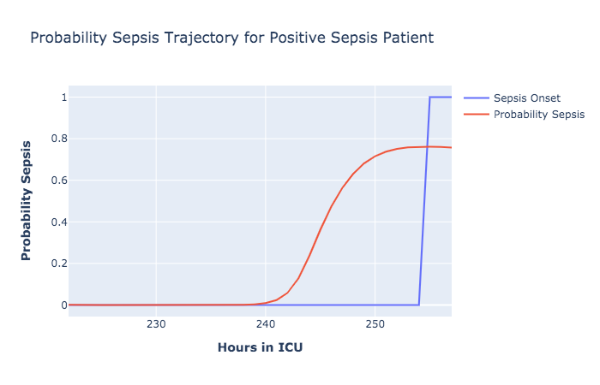
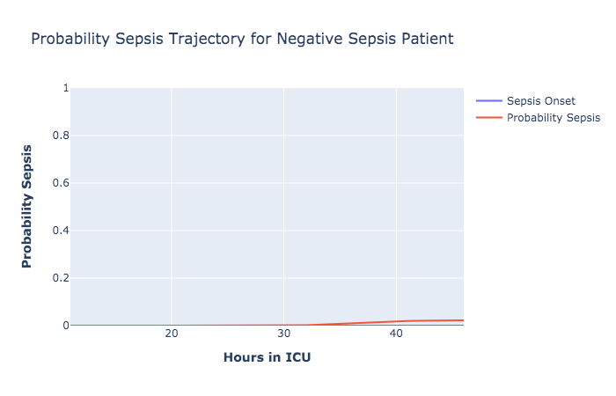
ICU Patient Typical Use Case
Sepsis
Notes:
Script
So lets walk though a typical use case. The first plot shows a patient who went into Sepsis at 254 hours, in blue. However, if you examine the probability trajectory around the 240th hour, the likelihood that this patient will go into sepsis is starting to go up. At around the 245th hour, just 10 hours before the patient goes into sepsis, the likelihood is now at 50%! Depending on the threshold chosen, a warning could be delivered to medical professionals in the ICU indicating that sepsis for this patient is imminent, allowing them to triage this patient and intervene. The next plot shows a patient that did not go into sepsis with low probabilities returned throughout.

Slide 10

Attention Saves Lives
On average, 91% recall at each hour
Currently, 66% of sepsis cases are caught in the ICU
40% more effective
Requires 36 hours of observation data
Missing lab data might be problem
Notes:
Slide 8
To sum up, using attention can help save patient lives. The average recall for the 36 hour prediction window is 91 %. And currently only about 66% of sepsis cases are correctly identified in the ICU. I can take the ratio of these two numbers and say that Attention identifies 40% more sepsis patients than what is currently being done.. A down side is that the medical professionals would need 36 hours of data, and complete labs, which might not always be the case.
*describe attention* talk about more

Slide 11
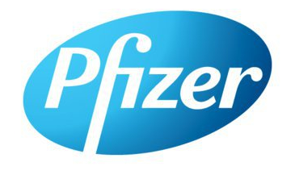






Jan Michael Austria
BS. Biochemistry
MS. Bioengineering
MS. Data Science
Notes:
So again my name is Mike. I received my undergraduate degree in biochemistry from Cornell. And have masters degrees from Tufts and the University of New Hampshire. I have a long career in pharmaceuticals and healthcare working at Pfizer and Lonza making vaccines. My passion is bridging the intersections with pharma, healthcare, and computer science to solve health related problems. Although not entirely related on forging a path to decarbonization, I’ve been helping patients and people for most of my career, and I’m excited about the idea of helping the community focus on sustainable energy initiatives. I would be more than happy contributing to the energy center community. Thank you!

Slide 12
Appendix
Notes:
Case in Point

Slide 13
Consequences of Predicting Wrong
Confusion Matrix
 | Actual Sepsis | Actual No Sepsis
Predicted Sepsis | 51402 | 519*
Predicted No Sepsis | 1050** | 3735309
*Type I error, predicting sepsis when not, wasting resources
**Type II error, predicting no sepsis when there is, BAD!!
Notes:
Script
So what are the consequence of predicting wrong? Of the patients that actually had sepsis, the classifier was only able to correctly identify 96% of them. The error in our classification would be the 4% that were not identified, which is a Type II error. In a hospital setting, we want to make sure sure we do not commit a Type II error, predicting no sepsis when there actually is. However, type I errors, where the algorithm predicts sepsis in the but the patient is not actually going into sepsis, is forgivable, but the hospital would be wasting staff and resources.

Slide 14
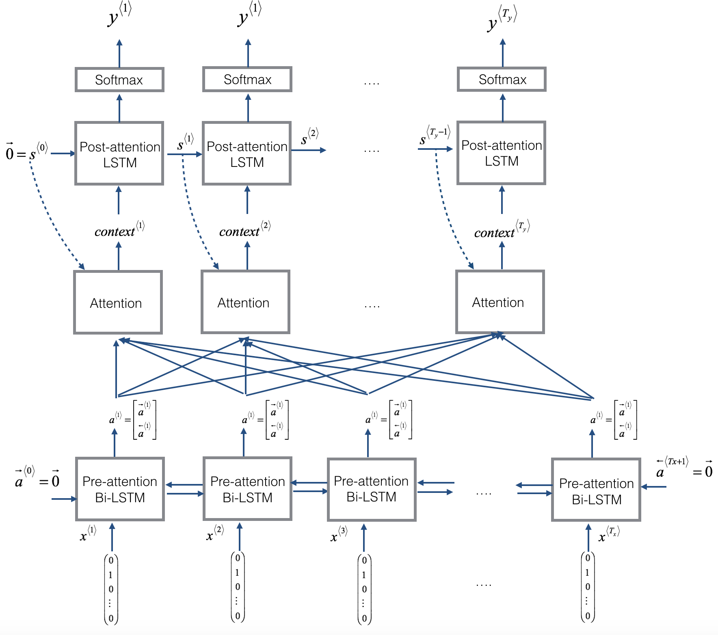

Slide 15
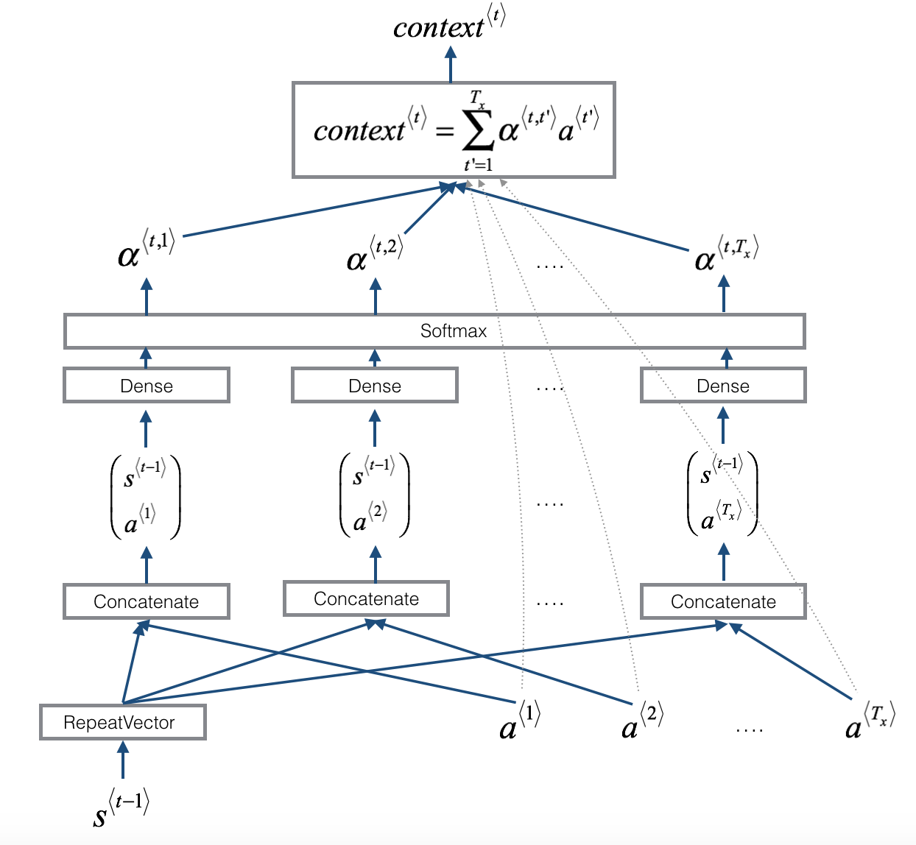

Slide 16
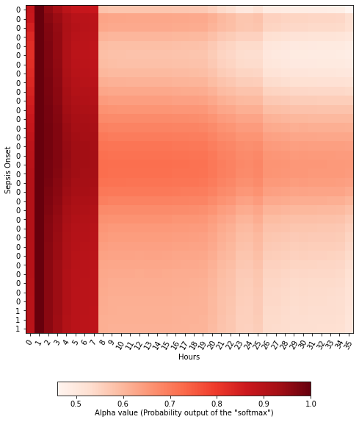
Attention Weights

Slide 17
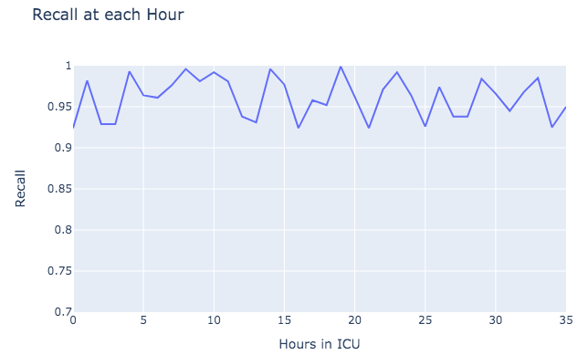
LSTM Test Set Metrics
Average Recall 96%
Out of 100 patients with Sepsis, the model will classify 96 of them.
Compared to current stats, about a 33% are detected
96 / 33 about 2 times more effective
Notes:
Since we are getting a prediction at each time point, we can show a metric for each. The plot shows the recall at each hour on the hold set set. Overall, the model is performing very well for each hour. Out of 100 patients who do develop sepsis, the model will classify 96 of them correctly. Roughly a third of the patients that do develop sepsis die because of being diagnosed too late. I can estimate this as 33 and take the ratio of my recall, showing that the estimator is 2 time more receptive.

Slide 18
Baseline Models to Beat – Proof of Concept
Cox Model – Survival Regression
Uses all available indicators as features - like linear regression
Does not treat it as a true time series, but used in medical literature quite often
Isolation Forest – Anomaly Detection
Sepsis of Prevalence is Low, 6% in this dataset
Decision Tree Rule Based Algorithm
Model | Precision | Recall | F1 | AUC
Cox Regression | .526 | .095 | .162 | .51
Isolation Forest | .97 | .02 | .02 | .53

Slide 19
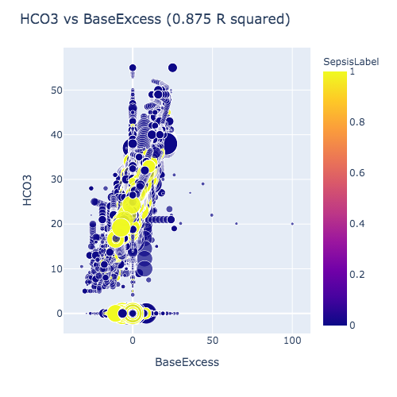
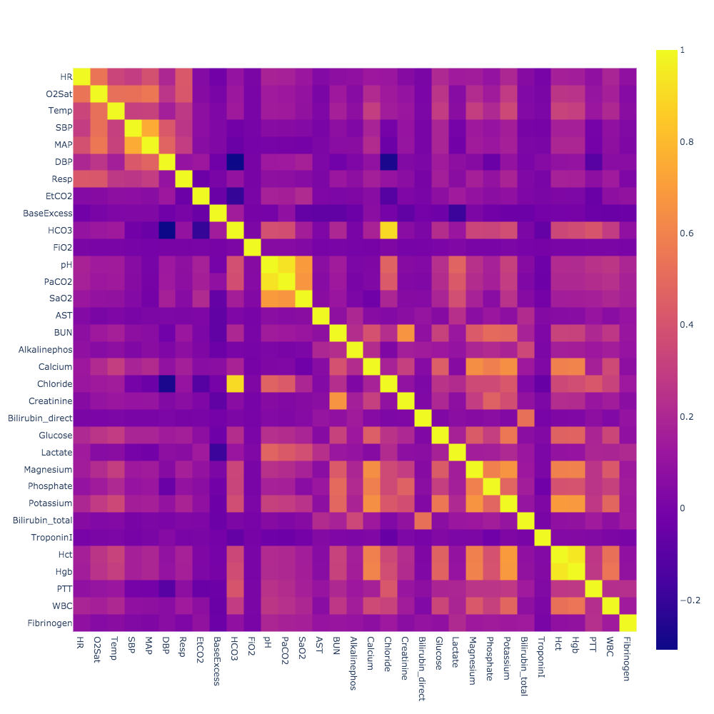
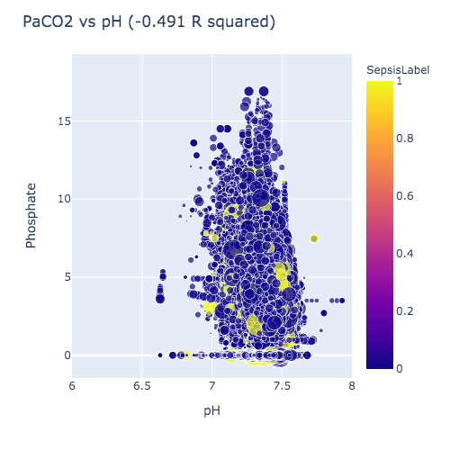
Time Independent Correlations
Highest Positive R squared
Highest Negative R squared
Notes:
Notes:
Although patient profiles are treated as time series, there are some features that are correlated independent of time. Because there are so many indicators, pairwise correlations would be hard to show. As a preliminary pass, I picked the highest values for positive r squared and negative r squared. Neither of which really separate the two classes by much, but there are correlations existing in the data.

Slide 20
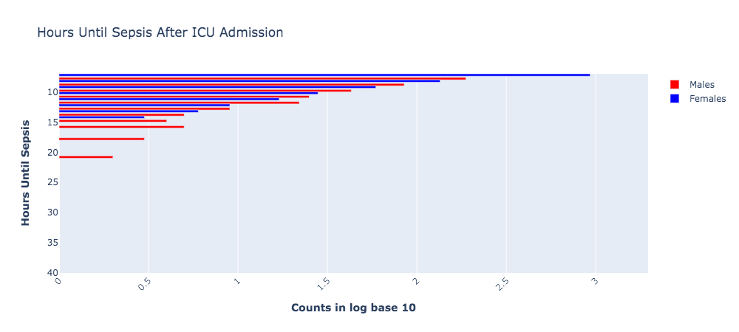
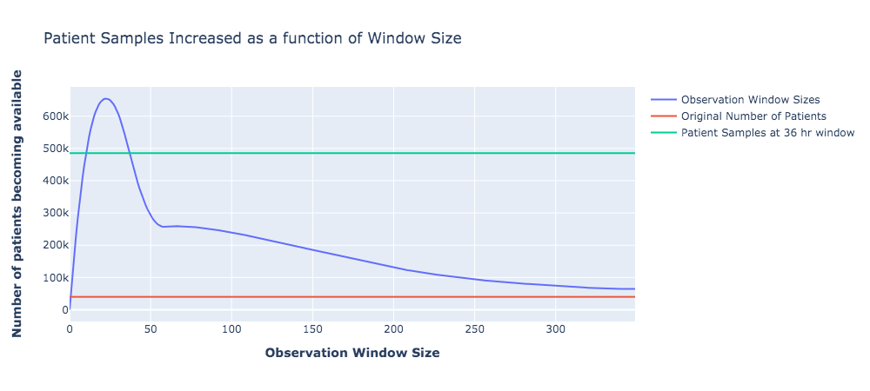
Class Imbalance and Observation Window Size
If patients do develop sepsis, most develop them within 7 to 15 hours
Depending on the observation window size, more ‘patient’ samples can be obtained.
36 hour window creates 500000 patient profiles
Started with 15000 patient profiles
Notes:
Slide 5
In the dataset there is a 6% prevalence of sepsis and if patients do develop sepsis most patients develop sepsis withing 7 to 10 hours after ICU admission. Another problem I ran into is that the lengths of observations for each patient are different. Some patients may have 400 hours of data and then go into sepsis, and some others maybe have only 10 hours of data but do not. So the length of the observation window becomes a problem. The bottom plot shows the number of ‘extra’ rows I can create as function of the observation window size - I can use a sliding window across a patient of a certain length, and each window can be treated as a new patient. Depending on the observation window size, more ‘patient’ samples can be obtained.
number of patients add something else

Slide 21
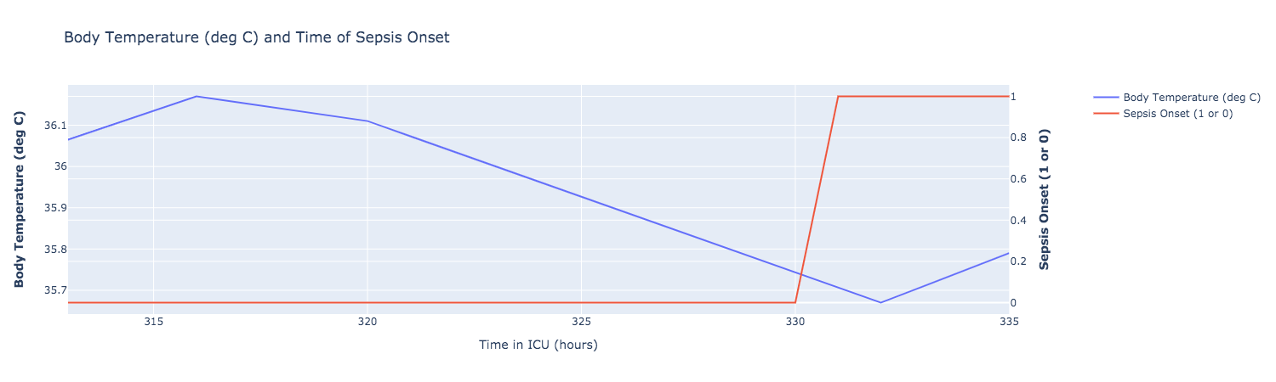
Example Sepsis Trajectory for ICU Patient
Sepsis at 331 hours
.8 @ 327 hours
.22 @ 323 hrs
Continuous probability prediction at each hour
Risk Score for a single ICU patient
Notes:
A typical patient profile looks something like this. What you are seeing the last 36 hours for that same ICU patient. The blue line indicates the patients body temp and the redline indicatd when the patient went into sepsis. The patient when into sepsis after 331 hours in the ICU. My idea is to to obtain a continuous probability stream at each time point indicating how likely sepsis is in the next 12 hours for a patient. This will can allow for risk score assignment for each patient at each hour and provide warnings when sepsis will happen for a patient.

Slide 22
Pipeline: Data Acquisition and Cleaning
Data From Hospitals In Boston(~15 million row entries - SQL)
Isolate ICU Patients (~4 million row entries)
Stratify By Indication (Sepsis onset vs Non sepsis)
Merge with Available Sensor Data (~2 million)
Aggregate to 1 Hour (~1.5 million rows)
Backtrack Sepsis Indicator by 12 hours
Interpolate to remove missing values
Adjust observation window to 36 hours
FINAL INPUT OUTPUT CREATION
Start!
End
Specific Problem becomes, can we predict whether or not a patient will go into septic shock in the next 12 hours given a 36-hour observation window!
Notes:
Slide 3
I started with the MICIV IV repository which contains 15 million patient records for some select hospitals in Boston. After a few queries, aggregating , merges, stratification and linkages with hospital lab and sensor data I end up with a clean interpolated multivariate time series for sepsis prediction. Followed by a few label offsets, the problem becomes: Can we predict whether or not a patient will go into septic shock in the next 12 hours given a 36 hour observation window!
Don’t call it MIMIC, be less specific

Slide 23
